Slide 1
Chapter 8.1
Common Core – A.APR.1 Understand that polynomials form a system analogous to the integers, namely, they are closed under the operations of addition, subtraction, and multiplication; add, subtract, and multiply polynomials.
Objective – To classify, add, and subtract polynomials.

Slide 2
Ch 8.1 Notes
Adding and Subtracting Polynomials
To find the Degree of the polynomial
Degree Name
7 0 Constant
8$x^{1}$ 1 Linear
2$x^{2} −7$ 2 Quadratic
$x^{3}{+ 2x}^{2}$ - 1 3 Cubic
$x^{4}{+ 2x}^{3}$ - 1 4 Quartic
$x^{5}{+ 2x}^{2}$ - 1 5 5th Degree

Slide 3
To name the polynomial by the number of Terms
Terms Name
7x 1 Monomial
8$x+6$ 2 Binomial
2$x^{2}−7x+3$ 3 Trinomial
$x^{3}{+ 2x}^{2}$ + x - 1 4 Polynomial

Slide 4
Standard Form for a Polynomial – you go from the highest power to the lowest power
To Add or Subtract a Polynomial – they have to have the same power to put them together
Ex. ${5x}^{3}{− 7x}^{2}$+ 2x – 4 + ${8x}^{3}{+ 3x}^{2}$+ 9x – 11
= ${13x}^{3}{− 4x}^{2}$+ 11x – 8

Slide 5
Chapter 8.2
Common Core – A.APR.1 Understand that polynomials form a system analogous to the integers, namely, they are closed under the operations of addition, subtraction, and multiplication; add, subtract, and multiply polynomials.
Objective – To multiply a monomial by a polynomial. To factor a monomial from a polynomial.

Slide 6
Ch 8.2 Notes
Simplify 8x (4$x^{2}$ - 5x + 2)
Find the Greatest Common Factor (GCF)
$${4x}^{4}{ −24x}^{3}{+ 12x}^{2}$$
Factor the polynomial
$${4x}^{4}{ −24x}^{3}{+ 12x}^{2}$$

Slide 7
Chapter 8.3
Common Core – A.APR.1 Understand that polynomials form a system analogous to the integers, namely, they are closed under the operations of addition, subtraction, and multiplication; add, subtract, and multiply polynomials.
Objective – To multiply two binomials or a binomial by a trinomial.

Slide 8
Ch 8.3 Notes
Multiplying Polynomials
Ex. (2x – 6) (3x + 7) by foiling
Ex. (4x + 6) (2x + 5)

Slide 9
Chapter 8.4
Common Core – A.APR.1 Understand that polynomials form a system analogous to the integers, namely, they are closed under the operations of addition, subtraction, and multiplication; add, subtract, and multiply polynomials.
Objective – To find the square of a binomial and to find the product of a sum and difference.

Slide 10

Ch 8.4 Notes
Multiplying Special Cases
Ex. ${(2x −3)}^{2}$
Ex. (5x + 9) (5x – 9)

Slide 11
Chapter 8.5
Common Core – A.SSE.1.a Interpret parts of an expression, such as terms, factors, and coefficients.
Objective – To factor trinomials of the form x² + bx + c

Slide 12
Ch 8.5 Notes
Factoring $x^{2}+bx+c$
Factor $x^{2}+8x+15$ (I am looking for factors
( ) ( ) of 15 that add up to 8)
Factor $x^{2}−10x+24$ (I am looking for factors
( ) ( ) of 24 that add up to -10)

Slide 13
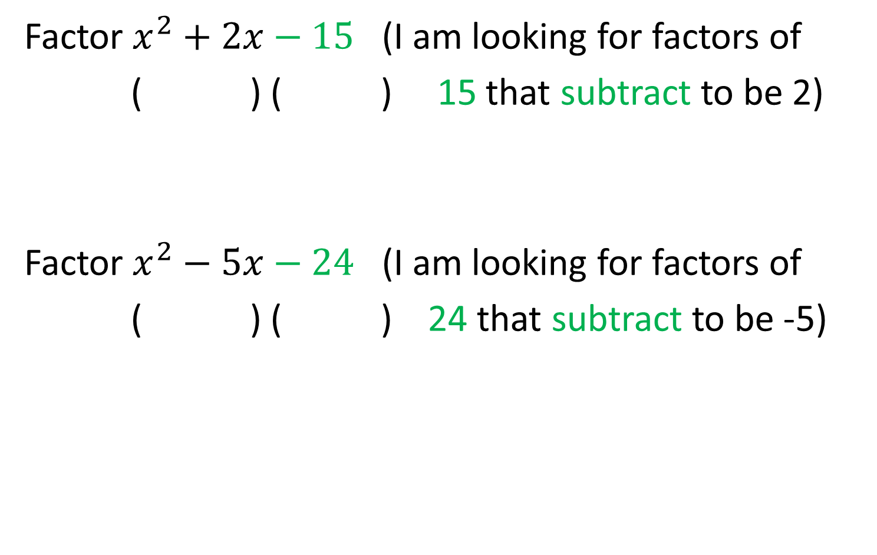
Factor $x^{2}+2x−15$ (I am looking for factors of
( ) ( ) 15 that subtract to be 2)
Factor $x^{2}−5x−24$ (I am looking for factors of
( ) ( ) 24 that subtract to be -5)

Slide 14
Chapter 8.6
Common Core – A.SSE.1.a Interpret parts of an expression, such as terms, factors, and coefficients.
Objective – To factor trinomials of the form ax² + bx + c

Slide 15
Ch 8.6 Notes
Factoring ${ax}^{2}+bx+c$
Factor 5$x^{2}+11x+2$ (I am looking for factors of 5
( ) ( ) and 2 that add up to 11)

Slide 16
Factor ${6x}^{2}+x−15$(I am looking for factors of 6
( ) ( ) and 15 that subtract to be 1)

Slide 17
Factor 18$x^{2}−33x+12$(I am looking for factors of
( ) ( ) 18 and 12 that add up to -33)

Slide 18
Factor ${2x}^{2}−13x−7$(I am looking for factors of 2
( ) ( ) and 7 that subtract to be -13)

Slide 19
Chapter 8.7
Common Core – A.SSE.1.a, A.SSE.1.b & A.SSE.2 Interpret parts of an expression, such as terms, factors, and coefficients.
Objective – To factor perfect-square trinomials and the differences of two squares.

Slide 20
Ch 8.7 Notes
Perfect Square Trinomials
$a^{2}$ + 2ab + $b^{2}$ = (a + b)(a + b) = (${a+b)}^{2}$
$a^{2}$ - 2ab + $b^{2}$ = (a - b)(a - b) = (${a−b)}^{2}$
Factor ${25x}^{2}$ - 60x + 36

Slide 21
Difference of Two Squares
$a^{2}$ - $b^{2}$ = (a + b)(a - b)
Factor ${16x}^{2}$ - 49

Slide 22
Chapter 8.8
Common Core – A.SSE.1.a, A.SSE.1.b & A.SSE.2 Interpret parts of an expression, such as terms, factors, and coefficients.
Objective – To factor higher-degree polynomials by grouping.

Slide 23
Ch 8.8 Notes
Factor by Grouping
Factor ${3x}^{3}$ - 12$x^{2}$ + 2x - 8

Slide 24
Factoring a Polynomial Completely
Factor ${4x}^{4}{−8x}^{3}+$ 12$x^{2}$ -24x

