Slide 1
Boot Camp 2011
Life Sciences

Slide 2
Keys to Keep
Scientific Investigation
Most scientific investigations include a hypothesis, an independent variable, a dependent variable, a set of constants, and a control group.
Depending on the data resulting from experiment or observation, a hypothesis can be accepted, modified, or rejected.

Slide 3
Scientific Investigation
An experiment and its procedures should be evaluated for their assumptions, clarity, thoroughness, and interpretation of data.
A scientific theory is a powerful explanation supported by tremendous amounts of data.
A scientific model is a simplified version of reality that shows some aspect of a complex structure or process.

Slide 4
Interpreting and Reporting Data
Data from scientific investigations must be communicated in ways that the audience will understand.
The Systeme International (SI) is the standard system of measurement used by scientists all over the world.
Graphs and tables are useful for organizing and showing patterns in large amounts of data.

Slide 5
Interpreting and Reporting Data
The mean, median, and/or mode can provide a useful description of a data set using a single number.
Computers are useful for collecting, analyzing, and displaying data, but interpretation of data is always up to human beings.

Slide 6
Laboratory Procedures and Equipment
Always evaluate the safety issues before you start a laboratory activity.
Safety symbols on bottles and worksheets can help you understand the risks involved in a laboratory activity.
High-school laboratories typically contain several types of equipment, including cylinders, beakers, pipettes, stopwatches, and balances.

Slide 7
Cell Structure and Function
The cell is the basic unit of life. New cells can arise only from other cells
Cells are made of four types of organic molecules: lipids, carbohydrates, proteins, and nucleic acids. Enzymes are proteins that control the chemical reactions necessary for life

Slide 8
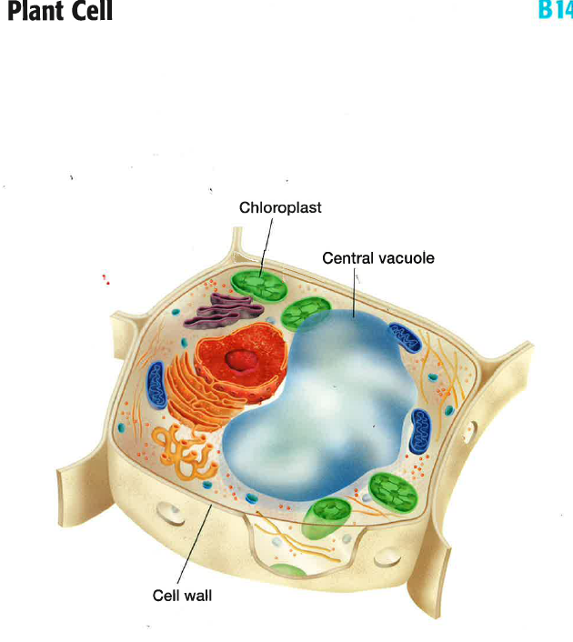

Slide 9
Cell Structure and Function
Some substances diffuse through a plasma membrane, others travel through protein channels, and some substances cannot pass through at all.
In diffusion, a substance moves from a region of higher concentration to a region of lower concentration. Osmosis is the diffusion of water molecules.

Slide 10
Cell Structure and Function
In active transport, a substance is forced from a region of lower concentration to a region of higher concentration.
A prokaryotic cell has no nucleus or membrane-bound organelles. A eukaryotic cell has a nucleus and membrane-bound organelles.

Slide 11
Cell Structure and Function
The organelles within a eukaryotic cell performs specialized functions such as protein production, waste disposal, transportation of substances, and energy production.
In a multicellular organism, the levels of organization from simplest to most complex are cells, tissues, organs, and organ systems.

Slide 12
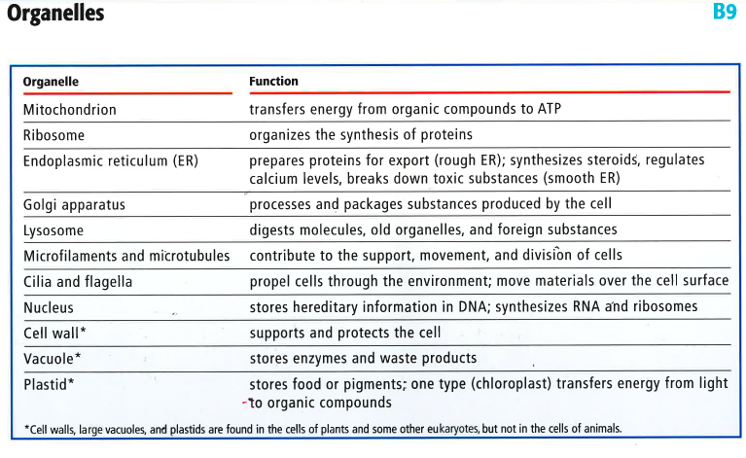

Slide 13
Fueling our Cells
Adenosine Triphosphate (ATP) is the molecule from which cells get energy to perform their life functions.
Photosynthesis requires light, carbon dioxide, water, and chlorophyll: it produces oxygen and food.

Slide 14
Photosynthesis
6CO₂ + 6H₂O + light energy → C₆H₁₂O₆ + 6O₂
Carbon dioxide + water + light energy, (in the presence of chlorophyll & enzymes) yields, glucose (sugar) & oxygen.

Slide 15
Fueling our Cells
Cell respiration requires food (such as glucose) and oxygen; it produces carbon dioxide, water, and energy in the form of ATP molecules.
Cell respiration has three stages, glycolysis, (transition), the Krebs cycle, and the electron transport chain. Cell respiration produces a total of 36 ATP molecules.

Slide 16
Respiration
(cellular, aerobic)
C₆H₁₂O₆ + 6O₂ → 6CO₂ + 6H₂O + energy
Glucose and oxygen yields carbon dioxide and energy.

Slide 17
Development and Variation
Most human cells contain 23 pairs of chromosomes, 46 total. Cells with a complete set of chromosomes are called diploid cells.
Human gametes (sex cells) contain 23 unpaired chromosomes. Gametes are called haploid cells.
The end result of mitosis is two daughter cells with the same number of chromosomes as the parent cell.

Slide 18
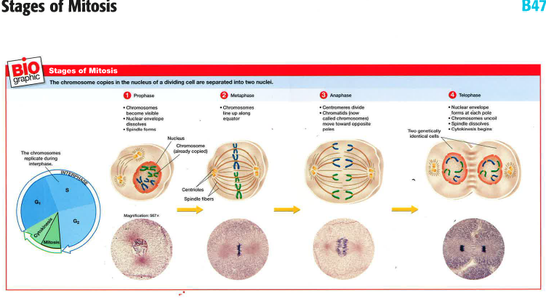

Slide 19
Development and Variation
The end result of meiosis is four daughter cells with half the number of chromosomes as the parent cell.
Meiosis produces four sperm cells in males; in females, only one of the four cells produced is a viable egg cell.

Slide 20
Development and Variation
Meiosis and sexual reproduction are important sources of variation in populations.
In fertilization, a haploid sperm cell and a haploid egg cell combine. The result is a diploid zygote, which then starts growing by mitosis.

Slide 21
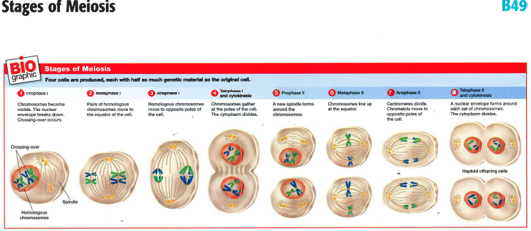

Slide 22
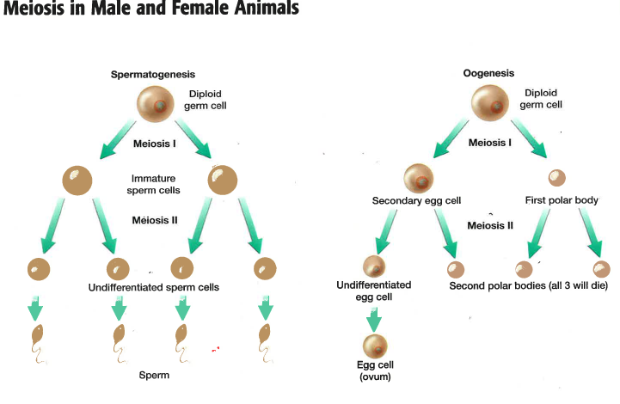

Slide 23
DNA and RNA
DNA is the molecule contained in the nucleus of a cell that carries the entire genetic information of an organism.
DNA can replicate itself, so that one parent molecule makes two daughter molecules.
Genes are the sections of a DNA molecule that carry the instructions for building proteins that perform cell functions and express traits.

Slide 24
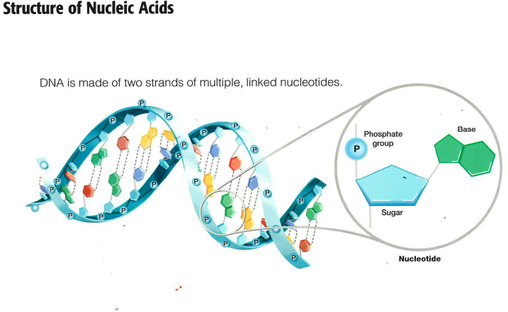

Slide 25
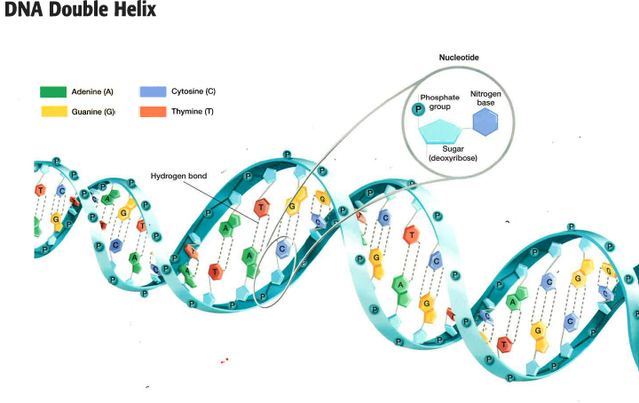

Slide 26
DNA and RNA
Through transcription, DNA encodes messages that cause proteins to form. mRNA carries this message outside of the nucleus.
Though translation, the message of mRNA is used to build a protein out of amino acids.

Slide 27
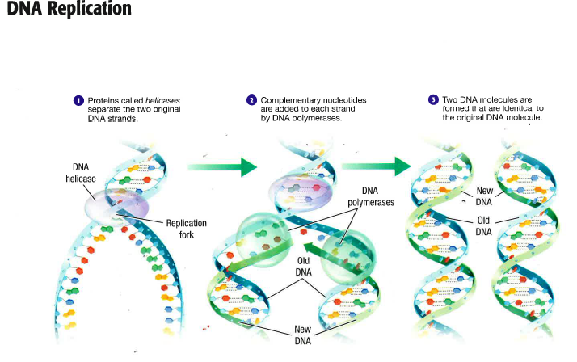

Slide 28
DNA and RNA
Point mutations occur during DNA replication, when a nucleotide is substituted, inserted, or deleted. Mutations can lead to minor or major changes in the structure and therefore the chemistry of a protein.
Mutation is one source of genetic variation in the population of a species.

Slide 29
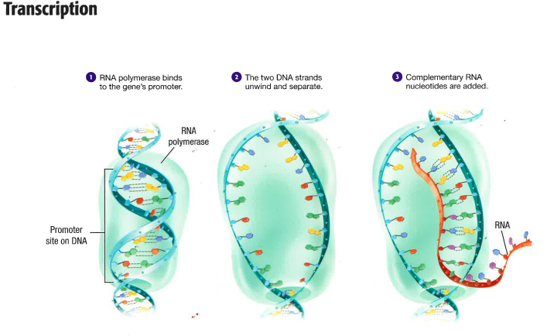

Slide 30
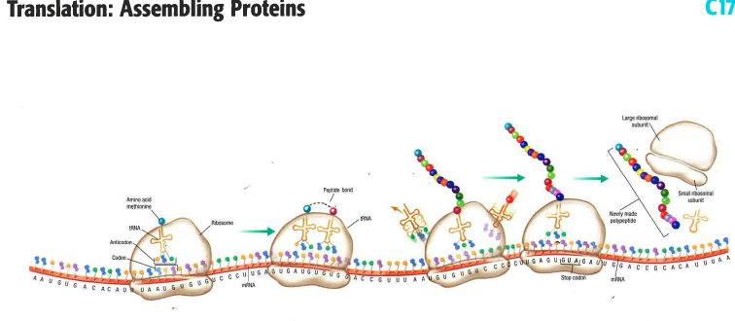

Slide 31
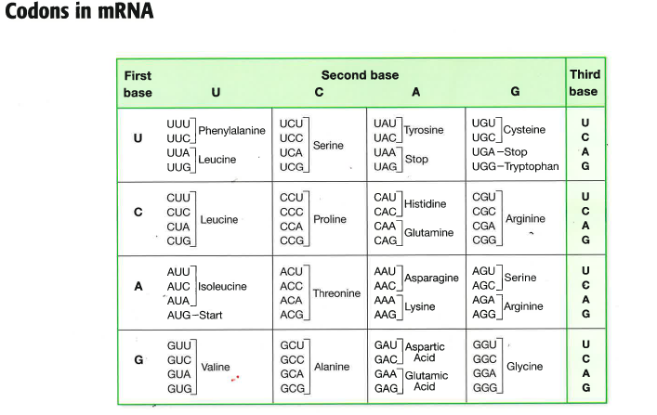

Slide 32
Genes and Alleles
Genes come in different forms called alleles.
A phenotype is an individual’s physical appearance; a genotype is an individual’s genetic makeup.
Some genes have three or more alleles, but only two alleles are present in any given genotype.

Slide 33
Genes and Alleles
An individual with two identical alleles for a trait is homozygous for that trait.
An individual with two different alleles for a trait is heterozygous for that trait.
Alleles can be in different relations of dominance to each other, including dominant recessive, incomplete dominance and codominance.

Slide 34
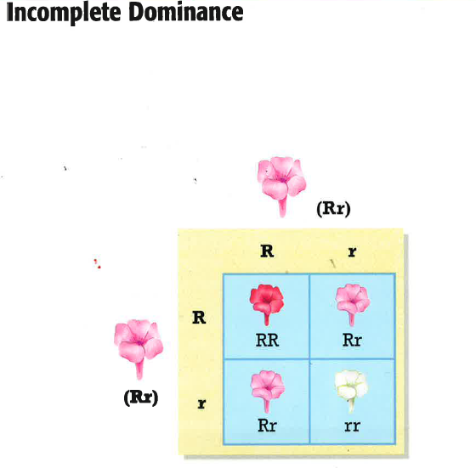

Slide 35
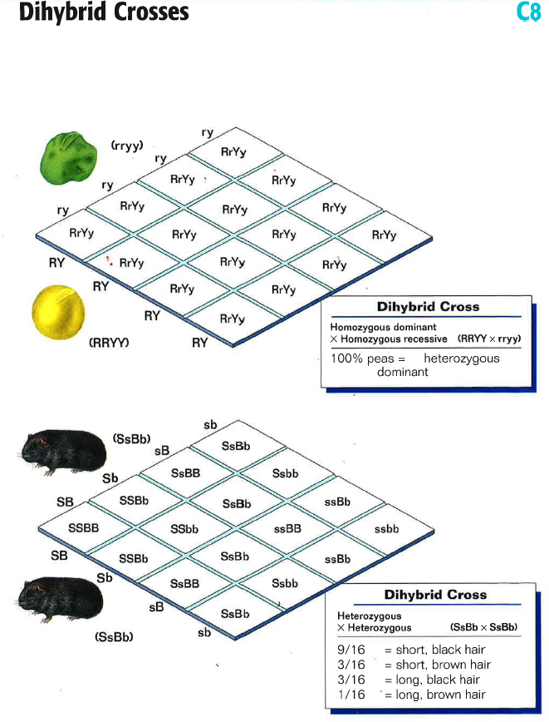

Slide 36
Genes and Alleles
Sex-linked traits are coded by alleles on the sex chromosomes.
Punnett squares are useful for finding the probability that offspring will have a trait.
Pedigrees are useful for tracking the transmission of a trait across generation.

Slide 37
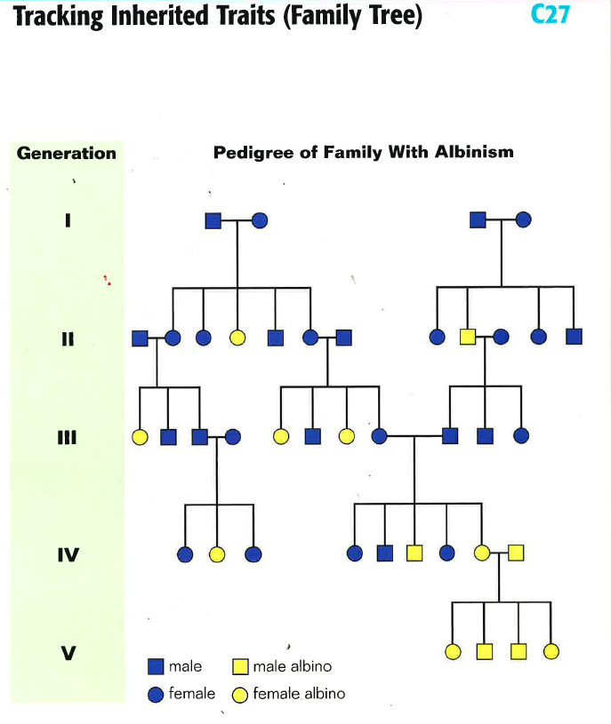

Slide 38
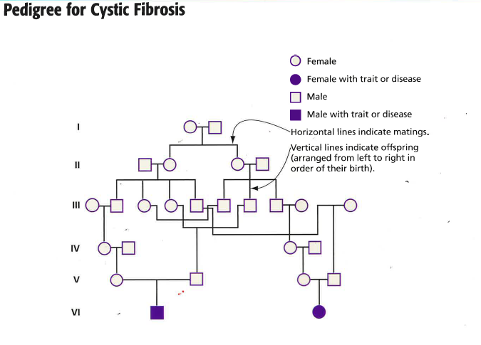

Slide 39
Evolution
Evolution is the change in a population’s genetic makeup over a long period of time.
A species is a group of organisms that can breed and produces fertile offspring. Evolution takes place at the level of species, not individuals.
Adaptations are traits within a population that help its members survive in a particular environment.

Slide 40
Evolution
The two main sources of variation in species that reproduce sexually are meiosis and mutation.
Natural selection is the process in which the pressure of the natural environment favor some traits in organisms over other traits.
Variation is the raw material for natural selection.

Slide 41
Evolution
Individuals with beneficial traits are likely to survive and pass on those traits to their offspring.
Speciation is the development of two or more new species from an original species.
Evidence of evolution includes similarities among the DNA of distantly related organisms, similarities in stages of embryonic development, homologous structures and the fossil record.

Slide 42
Relationships on the Tree of Life
Taxonomy is the science of classifying and naming organisms based on similarities and difference.
Most biologists recognize six kingdoms of life: Archea, Bacteria, Protista, Fungi, Plantae, and Animalia.
Important events in the evolution of animal life include the development of specialized tissues, bilateral symmetry, cephalization, and an internal body cavity.

Slide 43
Relationships on the Tree of Life
Binomial nomenclature, dichotomous keys, and cladograms are three of the tools that taxonomists use to classify organisms and relate them to each other.
Some results of evolution include adaptive radiation, convergent evolution, and coevolution.

Slide 44
Interacting with the Environment
All organisms have specialized receptors or cells that let them receive and respond to stimuli in their environments.
Plants exhibit tropisms in response to stimuli such as light, gravity, moisture, and so on
Animals respond to external stimuli by exhibiting innate responses such as taxes, reflexes, and instincts.

Slide 45
Interacting with the Environment
Through homeostasis, organisms maintain their internal environment.
Animals can learn to respond to external and internal stimuli.
Complex animal behaviors include migration, dormancy, mating rituals, territoriality, and schooling.

Slide 46
Abiotic Cycles in the Biosphere
On the Earth, vast cycles of matter continually move water, carbon, and nitrogen between the biotic and abiotic realms.
The hydrological cycle has a moderating effect on Earth’s climate.

Slide 47
Abiotic Cycles in the Biosphere
Sources of atmospheric CO₂ include respiring and decomposing plants and animals, erupting volcanoes, and burning fossil fuels.
Photosynthesis removes CO₂ from the atmosphere and fixes it into compounds that organisms can use for food and energy.
Most organisms can’t use atmospheric nitrogen directly. Bacteria fix nitrogen into compounds (ammonia, nitrate) that are useful to organisms.

Slide 48
Energy and Ecosystems
Ecosystems require a continual input of energy to sustain the organisms that live in them.
Ecologists organize ecosystems by trophic levels, or by “who eats whom.”
Matter cycles through an ecosystem; energy moves in a one-way path.
Only about 10% of the energy that enters on trophic level is available to the next trophic level.

Slide 49
Energy and Ecosystems
Energy, biomass, and the number of individuals in an ecosystem can be represented in trophic pyramids.
Food webs show “who eats whom” in more detail that a trophic pyramid typically does.
Important types of symbiosis include parasitism, commensalism, and mutualism.

Slide 50
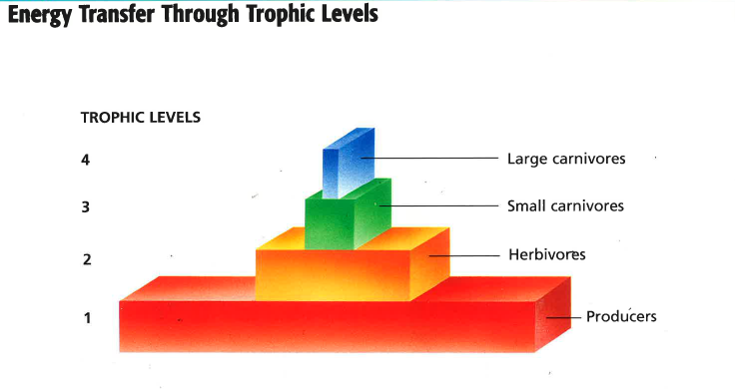

Slide 51
Populations
Living organisms have the capacity to produce populations of infinite size.
Limiting factors prevent populations from growing infinitely
Changes in population size can be graphed.

